Slide 1


Building
Scalable
Cloud Databases
Presented by:
Tim Lentine
@tlentine

Slide 2

Why This Session?
Building next-generation, cloud-based application to replace traditional client-server app;
Surveyed our client base and usage information to make design decisions for new product;
This talk is based in part on how we did this and lessons learned;

Slide 3

A Few Constraints
Relational Data;
NoSql isn’t a great fit;
Primarily a Microsoft Shop;
Very familiar with SQL Server;
Want ability to keep client data siloed as needed, and ability to scale (out and up) to meet demand;
(Ideally) Don’t really want to worry about things like backups, replication, etc;

Slide 4

So What Are Our Options?
SQL Server in a VM OR Azure SQL Database;
Single Tenant or Multi-Tenant Database Model
Roll our own solution or find something “off the shelf”;

Slide 5

Azure SQL Database
Options
DTU
Database Throughput Unit
A blended measure of CPU, memory, reads & writes
Flexible, changing compute sizes is possible with minimal downtime;
vCore
Gen 5: 1vCore = 1 hyper thread;
More traditional approach: you know how much memory and CPU you are getting;
Elastic Pools
All databases in pool share predefined resources
Great for sporadic uses by given customer;
Managed Instance
Relatively new offering
Great for migrating large numbers of existing SQL Server databases to the cloud;

Slide 6
Elastic Database Tools
(and Sharding)
FTW

Slide 7
Elastic Database Tools
Elastic Database Client Library: enables you to create and maintain sharded databases;
Elastic Database Split-Merge Tool: moves data between sharded databases;
Elastic Database Jobs: enables you to manage large numbers of Azure SQL Databases;
Elastic Database Query: enables you to run Transact-SQL query that spans multiple databases;

Slide 8
Sharding 101
“A Database Shard is a horizontal partition of data in a database or search engine”
–Wikipedia
“Sharding is a technique to distribute large amounts of identically structured data across a number of independent databases”
– Microsoft
https://docs.microsoft.com/en-us/azure/sql-database/sql-database-elastic-scale-introduction#sharding

Slide 9
Sharding: Key Terms
Shard: A database (in a shard set);
Shard Set: The group of Shards (databases) managed by the same Shard Map Manager;
Sharding Key: The column value that determines how data is distributed across shards (think CustomerID);
Shard Map: The set of mappings between sharding keys and their respective shards;
Shard Map Manager: A special database that maintains global mapping information about all shards in a shard set;
Shardlets: All of the data associated with a single value of a sharding key on a shard. The smallest unit of data movement possible when redistributing sharded tables;

Slide 10
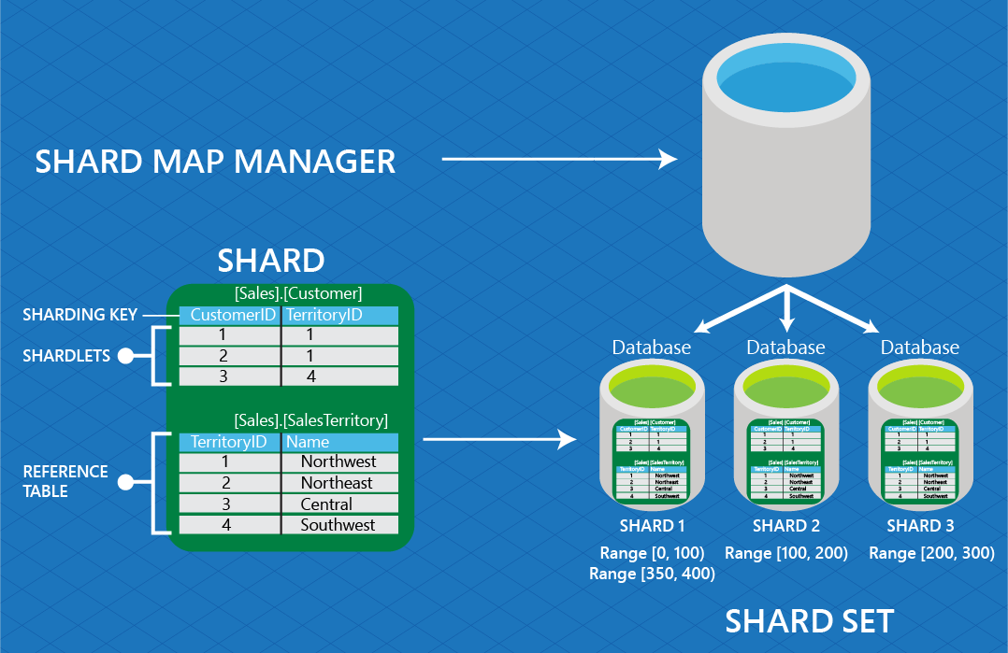
Source: https://docs.microsoft.com/en-us/azure/sql-database/sql-database-elastic-scale-glossary

Slide 11
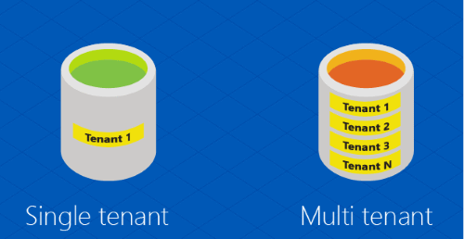
Sharding: Key Terms
Tenant: The end customer;
Single Tenant: One customer \ tenant per database;
Multi-Tenant: Several customers (tenants) packed together in a single database;
Data Dependent Routing: The functionality that enables an application to connect to a shard given a specific sharding key;
Multi-shard query: The ability to issue a query against multiple shards; result sets are returned using UNION ALL; aka “fan-out-query”;

Slide 12
Sharding Keys
Sharding Key: The column value that determines how data is distributed across shards (think CustomerID);
Supported Types:
integer
long
guid
byte[]
datetime
timespan
datetimeoffset

Slide 13
Shard Maps
Sharding Map: The set of mappings between sharding keys and their respective shards;
Types of Shard Maps
Depends on your database architecture:
Single Tenant / DB: Use List-Mapping shard map
Multiple Tenants / DB you have a choice:
List-Mapping: e.g. (1,5), (2,3,4), (6,10), (7,8), (9)
Range Mapping e.g. (1-100), (100-200), (200-N)

Slide 14
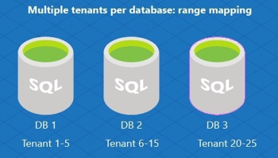
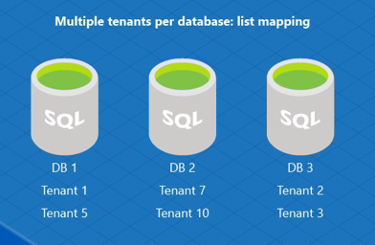
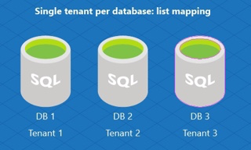
Source: https://docs.microsoft.com/en-us/azure/sql-database/sql-database-elastic-scale-shard-map-management

Slide 15

Where Do I Start?
“Greenfield” or “Brownfield” development?
Consistent usage of database, or sporadic/spiky traffic?
Single tenant per db or multiple tenants per db?
Any regulatory or similar data related concerns?
Notes:
If you have a single-tenant app that you want to make multi-tenant, it may be easiest to treat each customer \ tenant as a separate shard (db) rather than make it truly multi-tenant;
There are drawbacks (maintenance, deployments, etc)
There are pros (easier to move there, can provide .bacpac files to clients if needed, easier to restore db backups);

Slide 16

Opinion-Driven Development
Be careful of the Sharding Key type you use;
Particularly when designing multi-tenant databases;
Example: Guids lead to index fragmentation, can bloat database (16 bytes vs 4 for int);
Put reference \ lookup tables into a separate schema (not dbo);
ref.ZipCode or lkp.State
Be consistent with naming of database objects, including tables, field names, and particularly primary key fields;
Key fields should be easily recognizable not only to parent table but also the data type;
Id == bad
CustomerId == better
ixCustomer == best
(i = integer) (x = primary key) (Customer = parent table)

Slide 17
Elastic Database
Client Library
Client-side tools available for .NET or Java
Nuget: Microsoft.Azure.SqlDatabase.ElasticScale.Client
Library enables:
Ability to manage shards and shard maps;
Data-Dependent Routing;
Querying over multiple shards (multi-shard query);
Adding empty shards;
Cost $: Free!

Slide 18
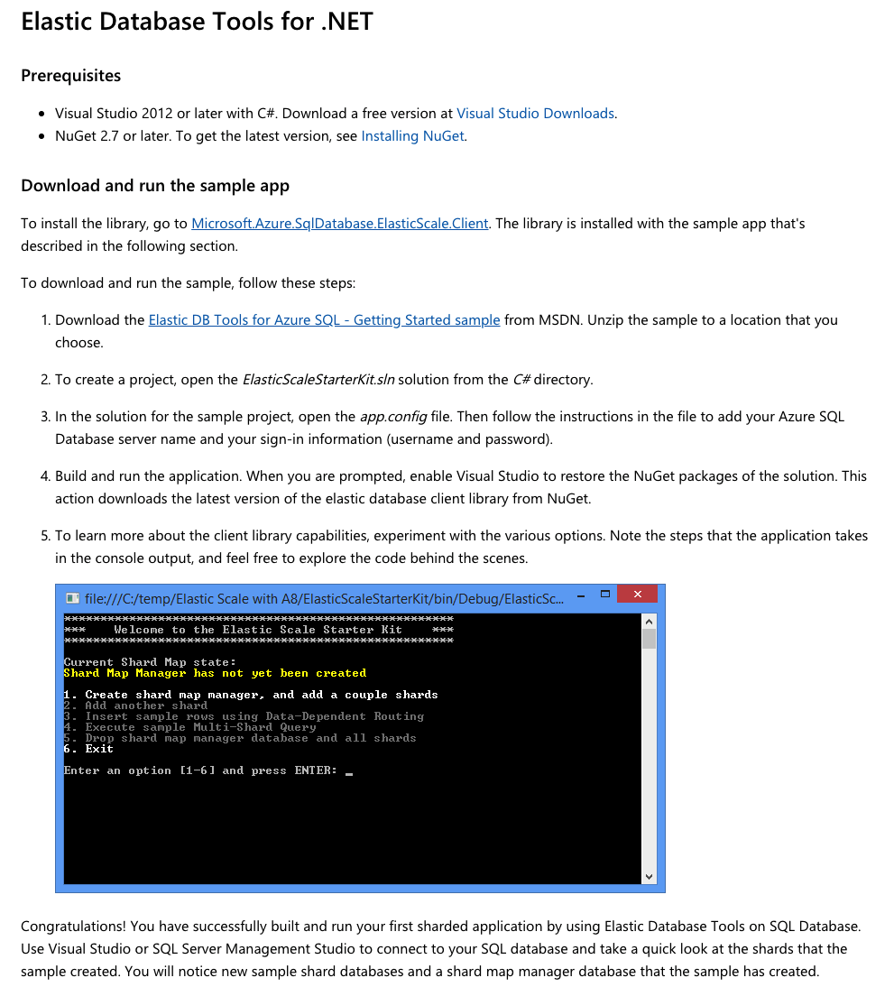
Sample App to Get Started

Slide 19
Client Library
Configuration
Create a new Shard Map Manager;
This is a special database that keeps track of the shards in the shard set;
One time operation to create the Shard Manager;
Add Shard(s) to Shard Map Manager;
Done as new shards are needed;
Define Range or List (PointMapping) to enable Data Dependent Routing (DDR);
Does not necessarily create the database & schema, though you can have EF trigger migrations;
(Optional) Apply SchemaInfoCollection details;
Identifies tables in schema that are either ShardedTableInfo or ReferenceTableInfo;
Necessary if you want to use Split-Merge functionality;

Slide 20

Shard Map Management tips
Keep Shard Management out of your main application;
Favor a dedicated “Management” app instead;
Demo apps from Microsoft don’t do this, but I think they should have a reference app that does : )
Be wary of “Code-First” EF Migrations;

Slide 21
Show Me The Data
Once you have a Shard Map Manager database & Shard(s), your application still needs to connect to the correct shard to retrieve data for any given request;
This is done via Data Dependent Routing (DDR);
At the same time, there may be situations where your app needs to query across all Shards for certain data.
This is accomplished via Multi-Shard Queries;

Slide 22

ShardMapManager
Applications connect to the Shard Map Manager database via a ShardMapManager instance;
The ShardMapManager opens connections to the correct databases when needed, based on the data in the shard map and the value of the ShardingKey;
ShardMapManager should be instantiated once per AppDomain, within the application initialization code;
The ShardMapManager contains caching logic to limit the number of requests that first hit the Shard Map Manager database before routing to the correct shard;

Slide 23
Entity Framework
Data Dependent Routing
Create a special ElasticScaleContext which wraps a DBContext;
Provide an instance of a ShardMap, the ShardingKey & the connection string to the ShardMapManager database to your ElasticScaleContext’s constructor;
Utilize the ShardMap.OpenConnectionForKey method which identifies which shard the key resides in and returns an open DbConnection to that shard (database);
Pass this DbConnection into the base DBContext;
Voila! EF will now query the correct shard for the request;

Slide 24
ADO.NET
Data Dependent Routing
Obtain either a RangeShardMap or ListShardMap from the ShardMapManager;
Use the OpenConnectionForKey method, providing the ShardingKey and ConnectionString to the ShardMapManager database;
The method will return an open SqlConnection to the correct database (shard);
Utilize the SqlConnection to process your SqlCommand;

Slide 25

Entity Framework
&
Multi-Shard Queries
Not Supported
But…
Elastic Client library is Open Source…

Slide 26
ADO.NET
Multi-Shard Queries
Instantiate a special MultiShardConnection providing ConnectionString to Shard Map Manager database and IEnumerable<Shards> to query;
Use this MultiShardConnection as you would a “normal” SqlConnection;

Slide 27

DEMO

Slide 28
Multi-Tenancy
&
Row Level Security
DDR get’s your request to the correct shard, but won’t prevent “Tenant Leakage™️”;
In Single-Tenant designs, this is probably fine;
For Multi-Tenant databases, strongly recommend using Row-Level Security with SQL Server to prevent issues;

Slide 29
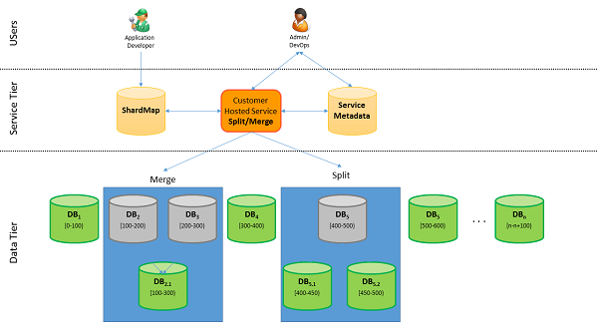
Split-Merge Tool
Allows you to redistribute data between shards as needed;
Runs as an Azure Web Service (Cloud Service with Web & Worker Roles);
Automatically keeps shard map up to date;
Data-Dependent routing connections are killed;
Connections to impacted shardlets are blocked until process completes;
Data-movement performed in batches of shardlets; Once batch is complete shardlets marked as online;
Connections to other shardlets in same shard also killed but will succeed immediately upon retry;
Source: https://docs.microsoft.com/en-us/azure/sql-database/sql-database-elastic-scale-overview-split-and-merge

Slide 30

When would you use
Split-Merge tool?
Need to grow beyond single database;
Need to increase overall capacity to handle explosive growth;
Shrink capacity due to seasonal nature of business;
Manage ‘hotspots’ by moving tenants around;

Slide 31

Elastic Database Jobs
Similar to SQL Agent jobs, but for Azure SQL Database;
Can target any number of Azure SQL Databases / Warehouses in the same Azure cloud as the job agent;
Azure Portal, PowerShell, T-SQL, Azure Resource Manager all supported;
Notes:
Create a new S0 or higher db which will serve as the Jobs Database
Create an Elastic Job Agent in the portal or with PowerShell
Define list of target databases for the job
Specify the job credential(s) for each database; (Database Scoped Credentials)
Create Job, add Job Steps, Run & Monitor

Slide 32

Elastic Jobs Uses
Some Examples:
Deploy new schema objects;
Re-index database;
Collect performance data;
A job’s T-SQL script must be Idempotent;
(If the script succeeds and it is run again, the same results occur)

Slide 33

Elastic Query
(Preview)
Provides ability to run T-SQL queries that span multiple Azure SQL Databases;
Similar to on-premise SQL Server queries that span multiple databases on same server instance OR Linked Servers;
Enables you to connect Microsoft and Third Party tools (e.g. Excel, Power BI, Tableau) to query across data tiers \ databases

Slide 34
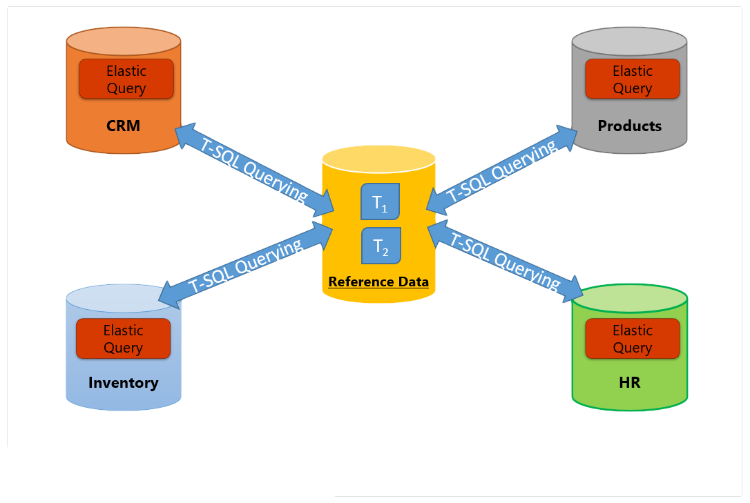
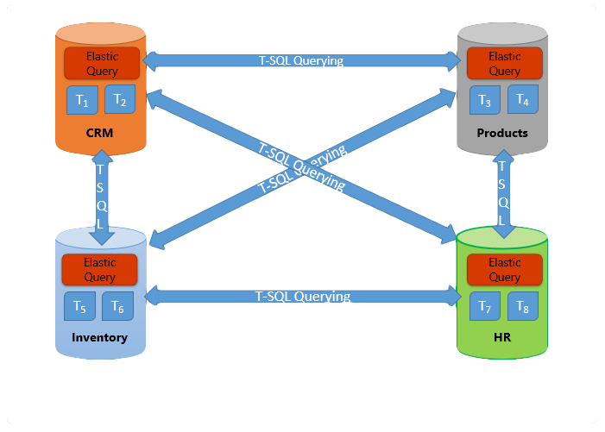
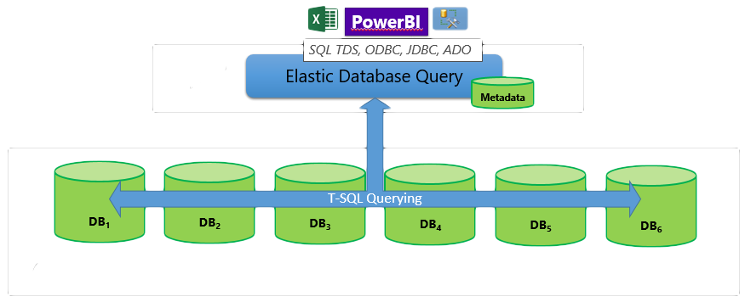
Elastic Query Uses
Query a reference database from other database(s);
Cross-database querying;
Reporting tasks over sharded databases;
Source: https://docs.microsoft.com/en-us/azure/sql-database/sql-database-elastic-query-overview
Notes:
Must run DDL scripts to make elastic query work; Differs depending upon usage;
For Sharding scenario:
CREATE MASTER KEY
CREATE DB SCOPED Credential
Create shard map (if not present)
Create External Datasource of type shard_map_manager
Create external table
Now you can access the horizontally partitioned table as though it were local. Azure SQL DB automatically opens multiple parallel connections to remote databases where data is physically stored.

Slide 35
Brief Recap
Azure SQL Database & Elastic Database Tools are flexible, albeit a little complicated;
Start with small proof of concepts;
Make sure you test your hypotheses around your usage scenarios and requirements;
Keep up to date (as best you can) with changes and new offerings from Microsoft;

Slide 36

Questions?

Slide 37

Thanks!

